Slide 1
01 SCILAB LECTURE
Ashok Ranade

Slide 2
Simulating an analog signal
x = f(t) : Both x and t are continuous variables
In practice measurement and calculation has to be done with finite precision
Manual simulation
Two parts
Calculation
Plotting

Slide 3
Problem
Write a program to plot the signal
x = 2t
t varies from 0 to 5
Since a straight line is required only two points are enough
Scilab calculates all the intermediate positions

Slide 4
Scilab variables
Stored as a matrix
We will used mostly one dimensional matrix
x = [ 1,5,-6,4];
x(1) = 1
x(2) = 5
x(3) = -6
x(4) = 4

Slide 5
Another method of generating an array
t = 0 : ts : T
t(1) = 0
t(2) = ts
t(3) = 2ts
t(4) = 3ts
.
.

Slide 6
Program to plot straight line
clc; clear; clf;
t = [0 5];
x = 2*t;
plot(t,x);
xlabel("Time","Fontsize",4);
ylabel("x","Fontsize",4);
xgrid(4);
title("Plot of straight line", "Fontsize",4);

Slide 7
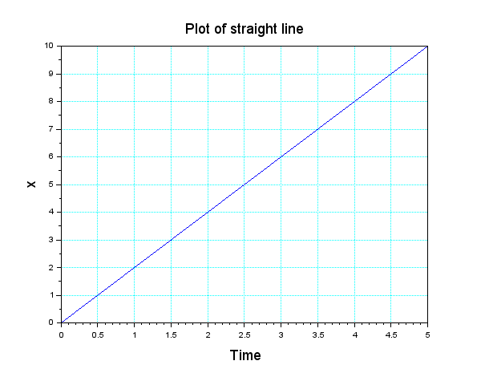
Graph

Slide 8
Modify the program
Modify the program to plot the straight line given by x = mt + C
The slope m and intercept C is user defined
Input function
m = input("Give slope ");
In the title print slope and intercept
String function
ms = string(m);

Slide 9
Program
clc; clear; clf;
m = input("Give slope ");
C = input("Give intercept ");
t = [0 5]; x = m*t+C;
ms = string(m);
Cs = string(C);
Title = ["straight line with slope",ms,"and intercept ",Cs]
plot(t,x);
xlabel("Time","Fontsize",4);
ylabel("x","Fontsize",4);
xgrid(4);
title(Title, "Fontsize",4);

Slide 10
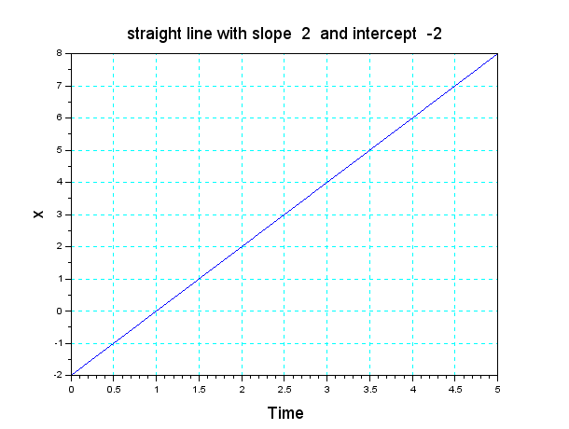
Output

Slide 11
Non linear curve plotting
Write a program to plot x = t²
Demonstrate that larger the number of points
smoother the curve will be
x*y is taken to be matrix multiplication
x.*y is point wise multiplication
x(1)y(1)
x(2)y(2) etc.

Slide 12
Subplot command
Subplot(211)
21 refers to two rows and 1 column
last 1 refers to graph 1
For example
subplot(211)
plot(t1,x)
subplot(212)
plot(t2,y)

Slide 13
Program
clear; clf;clc;
t1 = 0:2:6; t2 = 0:0.1:6;
x = t1.^2; y = t2.^2;
subplot(211);
plot(t1,x);
xlabel("Time","Fontsize",4);
ylabel("x","Fontsize",4);
xgrid(4);
title("Plot of square law relationship", "Fontsize",4);

Slide 14
Program continued
subplot(212);
plot(t2,y);
xlabel("Time","Fontsize",4);
ylabel("y","Fontsize",4);
xgrid(4);
title("Plot of square law relationship", "Fontsize",4);

Slide 15
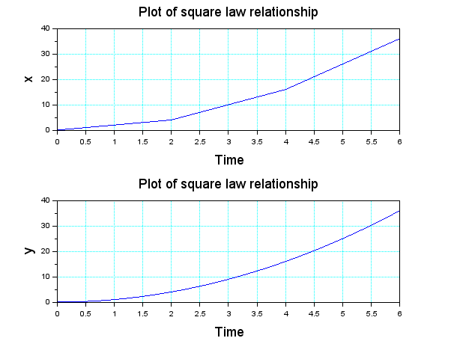
Program output

Slide 16
Simulating a sine wave
Inputs
Amplitude
Frequency
phase
Number of cycles to be plotted

Slide 17
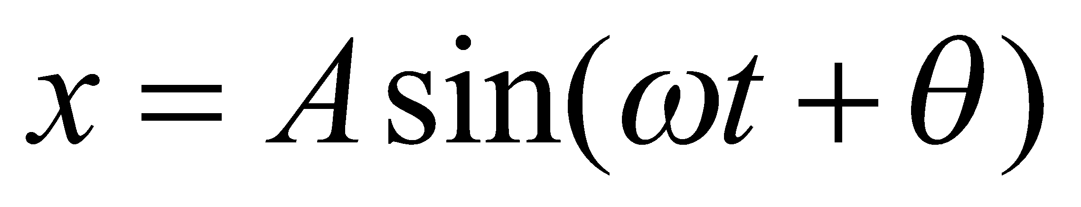
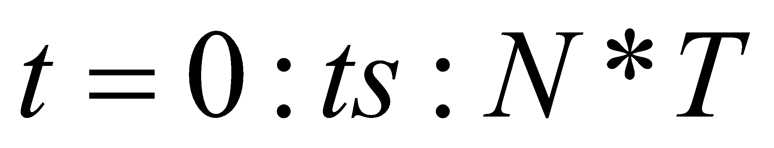
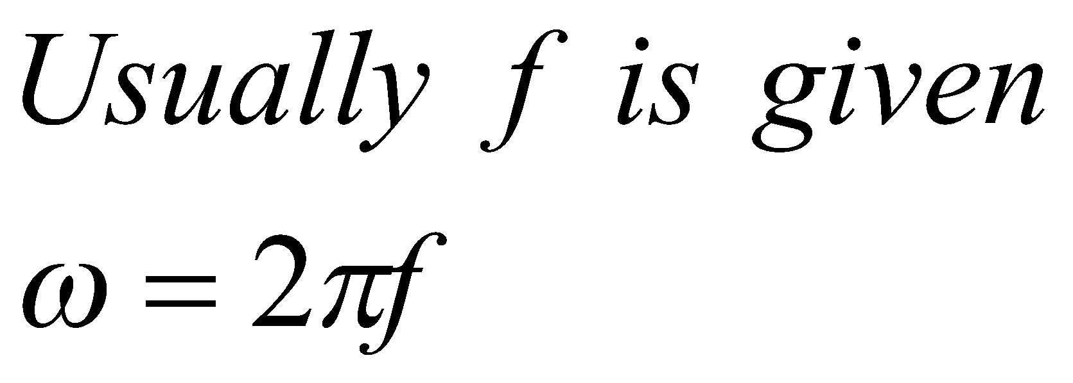
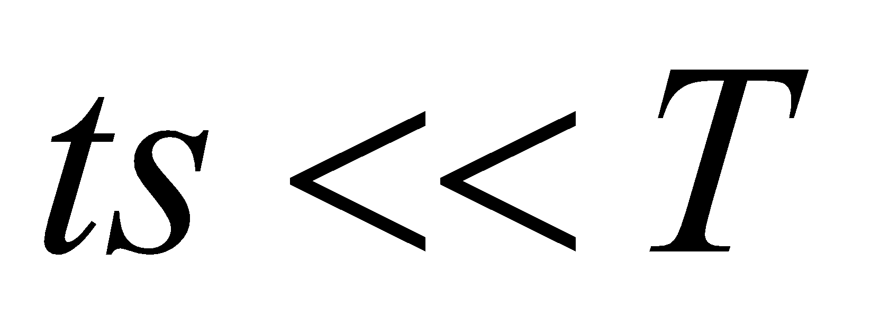
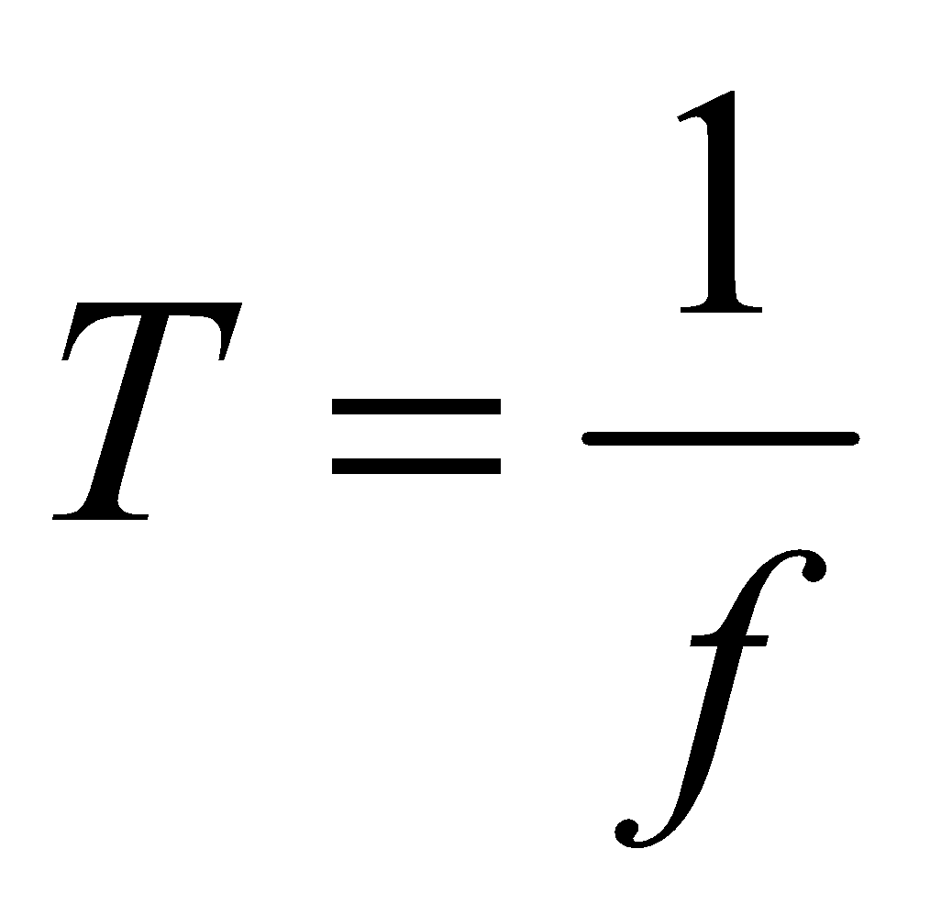
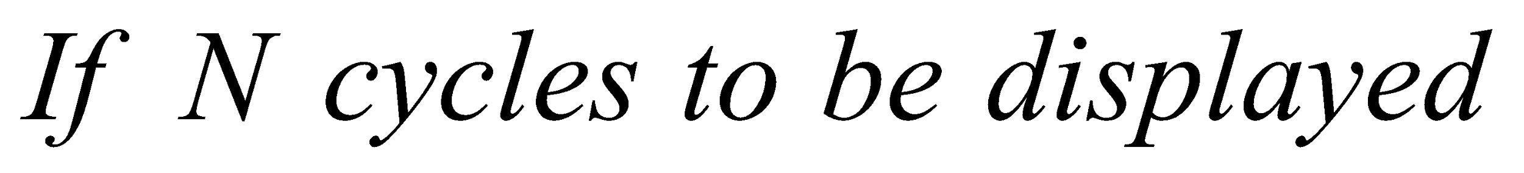
Calculations

Slide 18
Scilab program
// This program plots a CT sine wave
clear; clf;
A = 1; f = 100; T = 1/f; ts = T/100;
N = 6 ; // Number of cycles
w = 2*%pi*f; Theta =0 ; t = 0:ts:N*T;
x = A*sin(w*t + Theta);
plot(t,x ); xgrid(2);
xlabel("t", "fontsize",4);
ylabel("x(t)", "fontsize",4);
title(“ Sine wave of frequency f = 100 ", "fontsize",4);

Slide 19
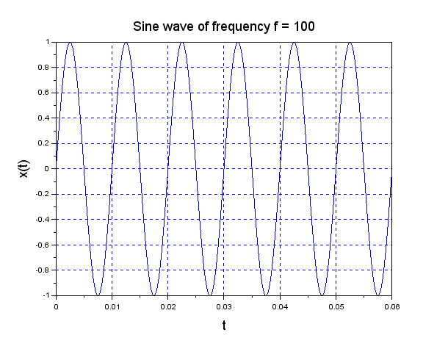
Program Output

